Slide 1
The CUDA Programming Model
© David Kirk/NVIDIA and Wen-mei W. Hwu, 2007
ECE 498AL, University of Illinois, Urbana-Champaign

Slide 2

What is GPGPU ?
General Purpose computation using GPU
in applications other than 3D graphics
  GPU accelerates critical path of application
Data parallel algorithms leverage GPU attributes
  Large data arrays, streaming throughput
  Fine-grain SIMD parallelism
  Low-latency floating point (FP) computation
Applications – see //GPGPU.org
  Game effects (FX) physics, image processing
  Physical modeling, computational engineering, matrix algebra, convolution, correlation, sorting
© David Kirk/NVIDIA and Wen-mei W. Hwu, 2007
ECE 498AL, University of Illinois, Urbana-Champaign
Notes:
Mark Harris, of Nvidia, runs the gpgpu.org website

Slide 3
Previous GPGPU Constraints
Dealing with graphics API
  Working with the corner cases of the graphics API
Addressing modes
  Limited texture size/dimension
Shader capabilities
  Limited outputs
Instruction sets
  Lack of Integer & bit ops
Communication limited
  Between pixels
  Scatter a[i] = p
per thread
per Shader
per Context
Input Registers
Fragment Program
Texture
Constants
Temp Registers
Output Registers
FB Memory
© David Kirk/NVIDIA and Wen-mei W. Hwu, 2007
ECE 498AL, University of Illinois, Urbana-Champaign

Slide 4
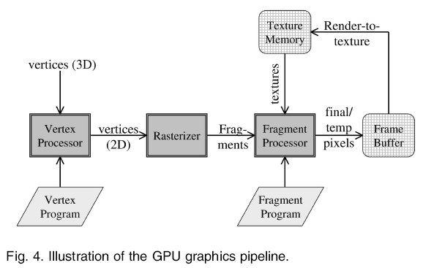
(from Liu et al. TPDS 2007)
© David Kirk/NVIDIA and Wen-mei W. Hwu, 2007
ECE 498AL, University of Illinois, Urbana-Champaign

Slide 5


CUDA
“Compute Unified Device Architecture”
General purpose programming model
  User kicks off batches of threads on the GPU
  GPU = dedicated super-threaded, massively data parallel co-processor
Targeted software stack
  Compute oriented drivers, language, and tools
Driver for loading computation programs into GPU
  Standalone Driver - Optimized for computation
  Interface designed for compute - graphics free API
  Data sharing with OpenGL buffer objects
  Guaranteed maximum download & readback speeds
  Explicit GPU memory management
© David Kirk/NVIDIA and Wen-mei W. Hwu, 2007
ECE 498AL, University of Illinois, Urbana-Champaign

Slide 6
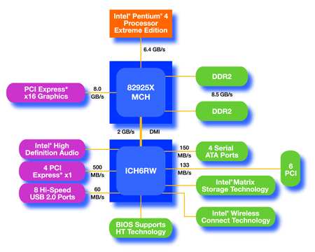
An Example of Physical Reality Behind CUDA
CPU
(host)
GPU w/
local DRAM
(device)
© David Kirk/NVIDIA and Wen-mei W. Hwu, 2007
ECE 498AL, University of Illinois, Urbana-Champaign

Slide 7
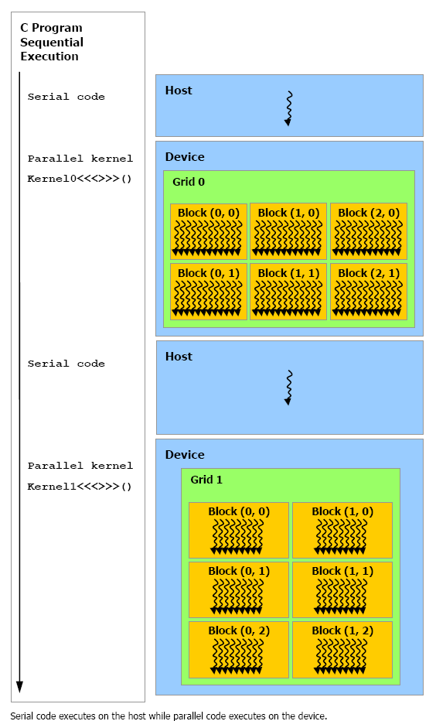
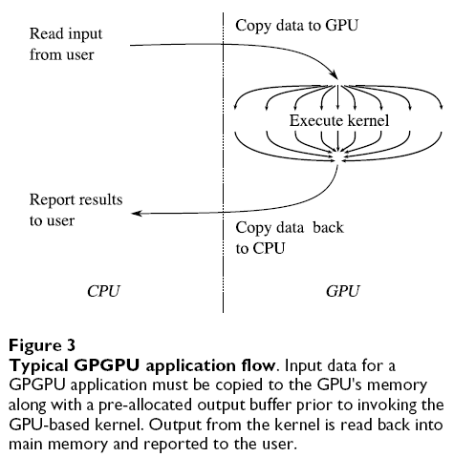
(from Schatz et al. BMC Bioinformatics 2007)
© David Kirk/NVIDIA and Wen-mei W. Hwu, 2007
ECE 498AL, University of Illinois, Urbana-Champaign

Slide 8
Extended C
Declspecs
  global, device, shared, local, constant
Keywords
  threadIdx, blockIdx
Intrinsics
  __syncthreads
Runtime API
  Memory, symbol, execution management
Function launch
__device__ float filter[N];
__global__ void convolve (float *image) {
__shared__ float region[M];
...
region[threadIdx] = image[i];
__syncthreads()
...
image[j] = result;
}
// Allocate GPU memory
void *myimage = cudaMalloc(bytes)
// 100 blocks, 10 threads per block
convolve<<<100, 10>>> (myimage);
© David Kirk/NVIDIA and Wen-mei W. Hwu, 2007
ECE 498AL, University of Illinois, Urbana-Champaign

Slide 9
Extended C
Integrated source
(foo.cu)
cudacc
EDG C/C++ frontend
Open64 Global Optimizer
GPU Assembly
foo.s
CPU Host Code
foo.cpp
OCG
gcc / cl
G80 SASS
foo.sass
© David Kirk/NVIDIA and Wen-mei W. Hwu, 2007
ECE 498AL, University of Illinois, Urbana-Champaign
Notes:
TBD: Define SASS = SPA Assembly language.

Slide 10
Overview
CUDA programming model – basic concepts and data types
CUDA application programming interface - basic
Simple examples to illustrate basic concepts and functionalities
Performance features will be covered later
© David Kirk/NVIDIA and Wen-mei W. Hwu, 2007
ECE 498AL, University of Illinois, Urbana-Champaign

Slide 11
CUDA Programming Model:
A Highly Multithreaded Coprocessor
The GPU is viewed as a compute device that:
  Is a coprocessor to the CPU or host
  Has its own DRAM (device memory)
  Runs many threads in parallel (SIMD, SIMT)
Data-parallel portions of an application are executed on the device as kernels which run in parallel on many threads
Differences between GPU and CPU threads
  GPU threads are extremely lightweight
    Very little creation overhead
  GPU needs 1000s of threads for full efficiency
    Multi-core CPU needs only a few
© David Kirk/NVIDIA and Wen-mei W. Hwu, 2007
ECE 498AL, University of Illinois, Urbana-Champaign

Slide 12
Thread Batching: Grids and Blocks
A kernel is executed as a grid of thread blocks
  All threads share data memory space
A thread block is a batch of threads that can cooperate with each other by:
  Synchronizing their execution
    For hazard-free shared memory accesses
  Efficiently sharing data through a low latency shared memory
Two threads from two different blocks cannot cooperate
Host
Device
Grid 1
Kernel 1
Block
(0, 0)
Block
(1, 0)
Block
(2, 0)
Block
(0, 1)
Block
(1, 1)
Block
(2, 1)
Grid 2
Kernel 2
Block (1, 1)
Thread
(0, 0)
Thread
(1, 0)
Thread
(2, 0)
Thread
(3, 0)
Thread
(4, 0)
Thread
(0, 1)
Thread
(1, 1)
Thread
(2, 1)
Thread
(3, 1)
Thread
(4, 1)
Thread
(0, 2)
Thread
(1, 2)
Thread
(2, 2)
Thread
(3, 2)
Thread
(4, 2)
© David Kirk/NVIDIA and Wen-mei W. Hwu, 2007
ECE 498AL, University of Illinois, Urbana-Champaign
Courtesy: NDVIA

Slide 13
Block and Thread IDs
Threads and blocks have IDs
  So each thread can decide what data to work on
  Block ID: 1D or 2D
  Thread ID: 1D, 2D, or 3D
Simplifies memory
addressing when processing
multidimensional data
  Image processing
  Solving PDEs on volumes
  …
Device
Grid 1
Block
(0, 0)
Block
(1, 0)
Block
(2, 0)
Block
(0, 1)
Block
(1, 1)
Block
(2, 1)
Block (1, 1)
Thread
(0, 0)
Thread
(1, 0)
Thread
(2, 0)
Thread
(3, 0)
Thread
(4, 0)
Thread
(0, 1)
Thread
(1, 1)
Thread
(2, 1)
Thread
(3, 1)
Thread
(4, 1)
Thread
(0, 2)
Thread
(1, 2)
Thread
(2, 2)
Thread
(3, 2)
Thread
(4, 2)
© David Kirk/NVIDIA and Wen-mei W. Hwu, 2007
ECE 498AL, University of Illinois, Urbana-Champaign
Courtesy: NDVIA

Slide 14
CUDA Device Memory Space Overview
Each thread can:
  R/W per-thread registers
  R/W per-thread local memory
  R/W per-block shared memory
  R/W per-grid global memory
  Read only per-grid constant memory
  Read only per-grid texture memory
(Device) Grid
Block (0, 0)
Block (1, 0)
Shared Memory
Shared Memory
Registers
Registers
Registers
Registers
Thread (0, 0)
Thread (1, 0)
Thread (0, 0)
Thread (1, 0)
Local
Memory
Local
Memory
Local
Memory
Local
Memory
The host can R/W global, constant, and texture memories
Host
Global
Memory
Constant
Memory
Texture
Memory
© David Kirk/NVIDIA and Wen-mei W. Hwu, 2007
ECE 498AL, University of Illinois, Urbana-Champaign
Notes:
Global, constant, and texture memory spaces are persistent across kernels called by the same application.

Slide 15
Global, Constant, and Texture Memories
(Long Latency Accesses)
Global memory
  Main means of communicating R/W Data between host and device
  Contents visible to all threads
Texture and Constant Memories
  Constants initialized by host
  Contents visible to all threads
(Device) Grid
Block (0, 0)
Block (1, 0)
Shared Memory
Shared Memory
Registers
Registers
Registers
Registers
Thread (0, 0)
Thread (1, 0)
Thread (0, 0)
Thread (1, 0)
Local
Memory
Local
Memory
Local
Memory
Local
Memory
Host
Global
Memory
Constant
Memory
Texture
Memory
© David Kirk/NVIDIA and Wen-mei W. Hwu, 2007
ECE 498AL, University of Illinois, Urbana-Champaign
Courtesy: NDVIA

Slide 16
CUDA – API
© David Kirk/NVIDIA and Wen-mei W. Hwu, 2007
ECE 498AL, University of Illinois, Urbana-Champaign

Slide 17
CUDA Highlights:
Easy and Lightweight
The API is an extension to the ANSI C programming language
Low learning curve
The hardware is designed to enable lightweight runtime and driver
High performance
© David Kirk/NVIDIA and Wen-mei W. Hwu, 2007
ECE 498AL, University of Illinois, Urbana-Champaign

Slide 18
A Small Detour: A Matrix Data Type
NOT part of CUDA
It will be frequently used in many code examples
  2 D matrix
  single precision float elements
  width * height elements
  pitch meaningful when the matrix is actually a sub-matrix of another matrix
  data elements allocated and attached to elements
typedef struct {
int width;
int height;
int pitch;
float* elements;
} Matrix;
© David Kirk/NVIDIA and Wen-mei W. Hwu, 2007
ECE 498AL, University of Illinois, Urbana-Champaign

Slide 19
CUDA Device Memory Allocation
cudaMalloc()
  Allocates object in the device Global Memory
  Requires two parameters
    Address of a pointer to the allocated object
    Size of of allocated object
cudaFree()
  Frees object from device Global Memory
    Pointer to freed object
(Device) Grid
Block (0, 0)
Block (1, 0)
Shared Memory
Shared Memory
Registers
Registers
Registers
Registers
Thread (0, 0)
Thread (1, 0)
Thread (0, 0)
Thread (1, 0)
Local
Memory
Local
Memory
Local
Memory
Local
Memory
Host
Global
Memory
Constant
Memory
Texture
Memory
© David Kirk/NVIDIA and Wen-mei W. Hwu, 2007
ECE 498AL, University of Illinois, Urbana-Champaign

Slide 20
CUDA Device Memory Allocation
(cont.)
Code example:
  Allocate a 64 * 64 single precision float array
  Attach the allocated storage to Md.elements
  “d” is often used to indicate a device data structure
BLOCK_SIZE = 64;
Matrix Md
int size = BLOCK_SIZE * BLOCK_SIZE * sizeof(float);
cudaMalloc((void**)&Md.elements, size);
cudaFree(Md.elements);
© David Kirk/NVIDIA and Wen-mei W. Hwu, 2007
ECE 498AL, University of Illinois, Urbana-Champaign

Slide 21
CUDA Host-Device Data Transfer
cudaMemcpy()
  memory data transfer
  Requires four parameters
    Pointer to source
    Pointer to destination
    Number of bytes copied
    Type of transfer
      Host to Host
      Host to Device
      Device to Host
      Device to Device
Asynchronous in CUDA 1.0
(Device) Grid
Block (0, 0)
Block (1, 0)
Shared Memory
Shared Memory
Registers
Registers
Registers
Registers
Thread (0, 0)
Thread (1, 0)
Thread (0, 0)
Thread (1, 0)
Local
Memory
Local
Memory
Local
Memory
Local
Memory
Host
Global
Memory
Constant
Memory
Texture
Memory
© David Kirk/NVIDIA and Wen-mei W. Hwu, 2007
ECE 498AL, University of Illinois, Urbana-Champaign

Slide 22
CUDA Host-Device Data Transfer
(cont.)
Code example:
  Transfer a 64 * 64 single precision float array
  M is in host memory and Md is in device memory
  cudaMemcpyHostToDevice and cudaMemcpyDeviceToHost are symbolic constants
cudaMemcpy(Md.elements, M.elements, size, cudaMemcpyHostToDevice);
cudaMemcpy(M.elements, Md.elements, size, cudaMemcpyDeviceToHost);
© David Kirk/NVIDIA and Wen-mei W. Hwu, 2007
ECE 498AL, University of Illinois, Urbana-Champaign

Slide 23
CUDA Function Declarations
 | Executed on the: | Only callable from the:
__device__ float DeviceFunc() | device | device
__global__ void KernelFunc() | device | host
__host__ float HostFunc() | host | host
__global__ defines a kernel function
  Must return void
__device__ and __host__ can be used together
© David Kirk/NVIDIA and Wen-mei W. Hwu, 2007
ECE 498AL, University of Illinois, Urbana-Champaign

Slide 24
CUDA Function Declarations
(cont.)
__device__ functions cannot have their address taken
For functions executed on the device:
  No recursion
  No static variable declarations inside the function
  No variable number of arguments
© David Kirk/NVIDIA and Wen-mei W. Hwu, 2007
ECE 498AL, University of Illinois, Urbana-Champaign

Slide 25
Calling a Kernel Function – Thread Creation
A kernel function must be called with an execution configuration:
__global__ void KernelFunc(...);
dim3 DimGrid(100, 50); // 5000 thread blocks
dim3 DimBlock(4, 8, 8); // 256 threads per block
size_t SharedMemBytes = 64; // 64 bytes of shared memory
KernelFunc<<< DimGrid, DimBlock, SharedMemBytes >>>(...);
Any call to a kernel function is asynchronous from CUDA 1.0 on, explicit synch needed for blocking
© David Kirk/NVIDIA and Wen-mei W. Hwu, 2007
ECE 498AL, University of Illinois, Urbana-Champaign

Slide 26
kernel_name <<<gridDim，blockDim>>> (arg1， arg2， ...); ooxx_kernel<<<123，32>>>(result， in1， in2);
Unique ID int id = blockIdx.x*blockDim.x + threadIdx.x;
© David Kirk/NVIDIA and Wen-mei W. Hwu, 2007
ECE 498AL, University of Illinois, Urbana-Champaign

Slide 27
The CUDA Memory Model
© David Kirk/NVIDIA and Wen-mei W. Hwu, 2007
ECE 498AL, University of Illinois, Urbana-Champaign

Slide 28
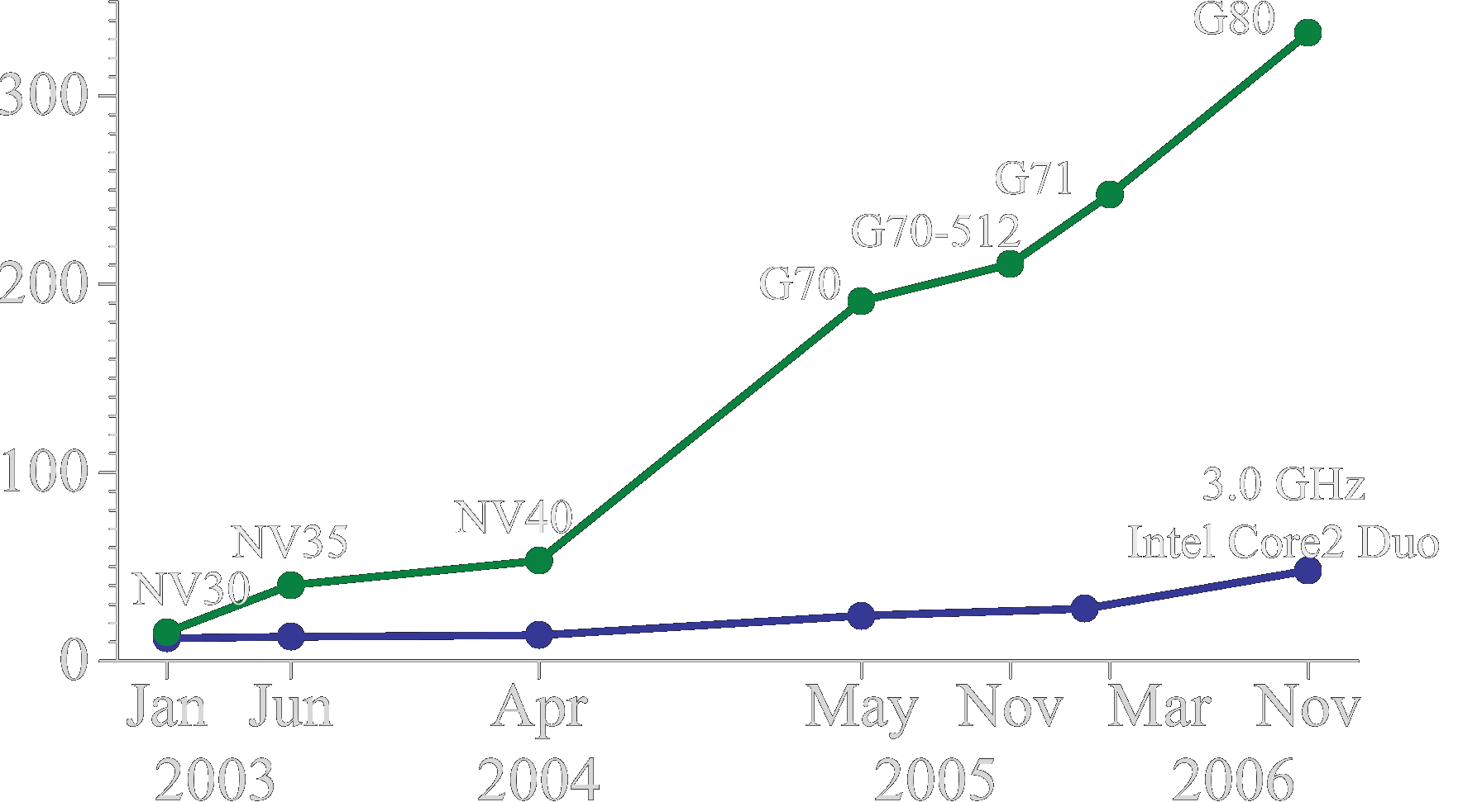
Why Use the GPU for Computing ?
The GPU has evolved into a very flexible and powerful processor:
  It’s programmable using high-level languages
  It supports 32-bit floating point precision
  It offers lots of GFLOPS:
GPU in every PC and workstation
GFLOPS
G80 = GeForce 8800 GTX
G71 = GeForce 7900 GTX
G70 = GeForce 7800 GTX
NV40 = GeForce 6800 Ultra
NV35 = GeForce FX 5950 Ultra
NV30 = GeForce FX 5800
© David Kirk/NVIDIA and Wen-mei W. Hwu, 2007
ECE 498AL, University of Illinois, Urbana-Champaign

Slide 29
What is Behind such an Evolution?
The GPU is specialized for compute-intensive, highly data parallel computation (exactly what graphics rendering is about)
  So, more transistors can be devoted to data processing rather than data caching and flow control
The fast-growing video game industry exerts strong economic pressure that forces constant innovation
Control
ALU
ALU
ALU
ALU
CPU
GPU
Cache
DRAM
DRAM
© David Kirk/NVIDIA and Wen-mei W. Hwu, 2007
ECE 498AL, University of Illinois, Urbana-Champaign

Slide 30
split personality
n.
Two distinct personalities in the same entity,
each of which prevails at a particular time.
© David Kirk/NVIDIA and Wen-mei W. Hwu, 2007
ECE 498AL, University of Illinois, Urbana-Champaign

Slide 31
G80 Thread Computing Pipeline
Processors execute computing threads
Alternative operating mode specifically for computing
The future of GPUs is programmable processing
So – build the architecture around the processor
Host
Input Assembler
Host
Thread Execution Manager
Input Assembler
Setup / Rstr / ZCull
Vtx Thread Issue
Geom Thread Issue
Pixel Thread Issue
SP
SP
SP
SP
SP
SP
SP
SP
SP
SP
SP
SP
SP
SP
SP
SP
Parallel Data
Cache
Parallel Data
Cache
Parallel Data
Cache
Parallel Data
Cache
Parallel Data
Cache
Parallel Data
Cache
Parallel Data
Cache
Parallel Data
Cache
Texture
Thread Processor
Texture
Texture
Texture
Texture
Texture
Texture
Texture
Texture
TF
L1
TF
L1
TF
L1
TF
L1
TF
L1
TF
L1
TF
L1
TF
L1
Load/store
Load/store
Load/store
Load/store
Load/store
Load/store
L2
L2
L2
L2
L2
L2
Global Memory
FB
FB
FB
FB
FB
FB
© David Kirk/NVIDIA and Wen-mei W. Hwu, 2007
ECE 498AL, University of Illinois, Urbana-Champaign

Slide 32
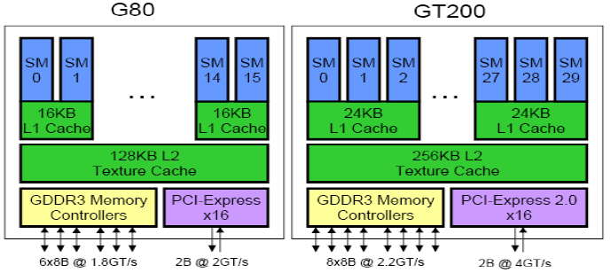
from David Kanter
© David Kirk/NVIDIA and Wen-mei W. Hwu, 2007
ECE 498AL, University of Illinois, Urbana-Champaign

Slide 33
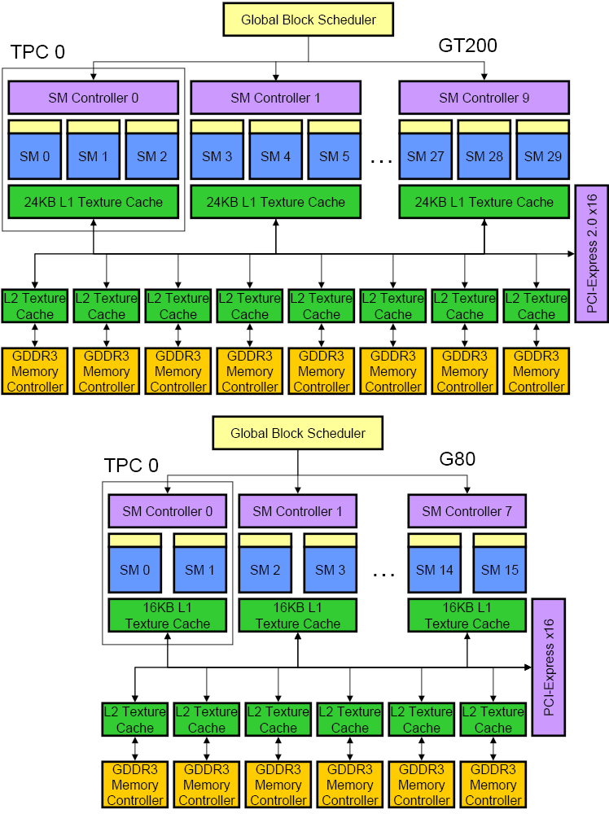
from David Kanter
© David Kirk/NVIDIA and Wen-mei W. Hwu, 2007
ECE 498AL, University of Illinois, Urbana-Champaign

Slide 34
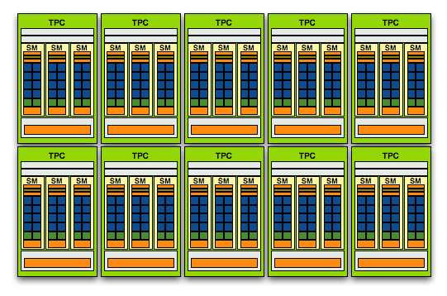
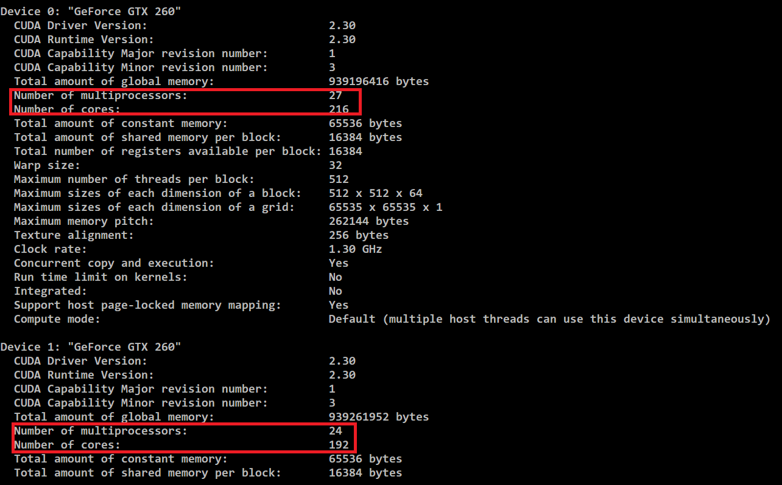
© David Kirk/NVIDIA and Wen-mei W. Hwu, 2007
ECE 498AL, University of Illinois, Urbana-Champaign

Slide 35
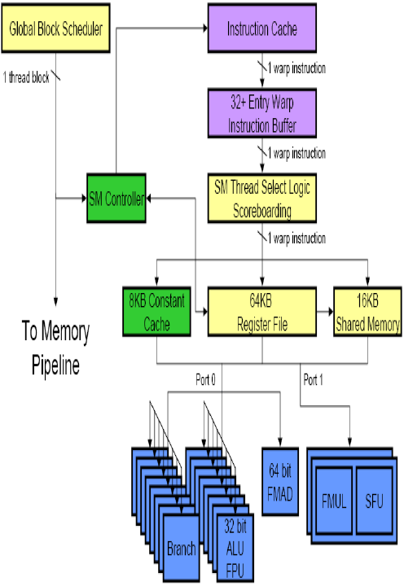
from David Kanter
© David Kirk/NVIDIA and Wen-mei W. Hwu, 2007
ECE 498AL, University of Illinois, Urbana-Champaign

Slide 36
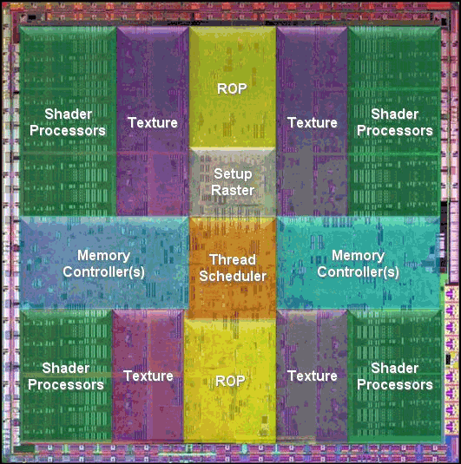
from David Kanter
© David Kirk/NVIDIA and Wen-mei W. Hwu, 2007
ECE 498AL, University of Illinois, Urbana-Champaign

Slide 37
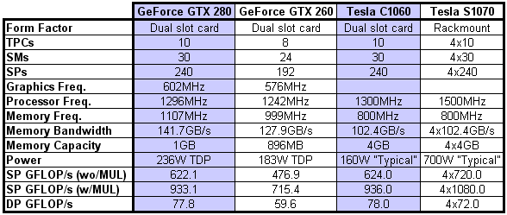
from David Kanter
© David Kirk/NVIDIA and Wen-mei W. Hwu, 2007
ECE 498AL, University of Illinois, Urbana-Champaign

Slide 38
GeForce 8800 Series Technical Specs
Maximum number of threads per block: 512
Maximum size of each dimension of a grid: 65,535
Number of streaming multiprocessors (SM):
  GeForce 8800 GTX: 16 @ 675 MHz
  GeForce 8800 GTS: 12 @ 600 MHz
Device memory:
  GeForce 8800 GTX: 768 MB
  GeForce 8800 GTS: 640 MB
Shared memory per multiprocessor: 16KB divided in 16 banks
Constant memory: 64 KB
Warp size: 32 threads (16 Warps/Block)
© David Kirk/NVIDIA and Wen-mei W. Hwu, 2007
ECE 498AL, University of Illinois, Urbana-Champaign

Slide 39
What is the GPU Good at?
The GPU is good at
data-parallel processing
    The same computation executed on many data elements in parallel – low control flow overhead
with high SP floating point arithmetic intensity
    Many calculations per memory access
    Currently also need high floating point to integer ratio
High floating-point arithmetic intensity and many data elements mean that memory access latency can be hidden with calculations instead of big data caches – Still need to avoid bandwidth saturation!
© David Kirk/NVIDIA and Wen-mei W. Hwu, 2007
ECE 498AL, University of Illinois, Urbana-Champaign

Slide 40
Drawbacks of (legacy) GPGPU Model: Hardware Limitations
Memory accesses are done as pixels
  Only gather: can read data from other pixels
  No scatter: (Can only write to one pixel)
  Less programming flexibility
Control
ALU
ALU
ALU
...
Control
ALU
ALU
ALU
...
…
Cache
Cache
DRAM
d₀
d₁
d₂
d₃
d₄
d₅
d₆
d₇
…
Control
ALU
ALU
ALU
...
Control
ALU
ALU
ALU
...
…
Cache
Cache
DRAM
d₀
d₁
d₂
d₃
d₄
d₅
d₆
d₇
…
© David Kirk/NVIDIA and Wen-mei W. Hwu, 2007
ECE 498AL, University of Illinois, Urbana-Champaign

Slide 41
Drawbacks of (legacy) GPGPU Model: Hardware Limitations
Applications can easily be limited by DRAM memory bandwidth
Waste of computation power due to data starvation
Control
ALU
ALU
ALU
...
Control
ALU
ALU
ALU
...
Cache
Cache
DRAM
d₀
d₁
d₂
d₃
d₄
d₅
d₆
d₇
…
© David Kirk/NVIDIA and Wen-mei W. Hwu, 2007
ECE 498AL, University of Illinois, Urbana-Champaign

Slide 42
CUDA Highlights: Scatter
CUDA provides generic DRAM memory addressing
  Gather:
  And scatter: no longer limited to write one pixel
More programming flexibility
Control
ALU
ALU
ALU
...
Control
ALU
ALU
ALU
...
…
Cache
Cache
DRAM
d₀
d₁
d₂
d₃
d₄
d₅
d₆
d₇
…
Control
ALU
ALU
ALU
...
Control
ALU
ALU
ALU
...
…
Cache
Cache
DRAM
d₀
d₁
d₂
d₃
d₄
d₅
d₆
d₇
…
© David Kirk/NVIDIA and Wen-mei W. Hwu, 2007
ECE 498AL, University of Illinois, Urbana-Champaign

Slide 43
CUDA Highlights:
On-Chip Shared Memory
CUDA enables access to a parallel on-chip shared memory for efficient inter-thread data sharing
Big memory bandwidth savings
Control
ALU
ALU
ALU
...
Control
ALU
ALU
ALU
...
Cache
Cache
…
Shared
memory
Shared
memory
d₀
d₁
d₂
d₃
d₄
d₅
d₆
d₇
DRAM
d₀
d₁
d₂
d₃
d₄
d₅
d₆
d₇
…
© David Kirk/NVIDIA and Wen-mei W. Hwu, 2007
ECE 498AL, University of Illinois, Urbana-Champaign

Slide 44
Programming Model:
Memory Spaces
Grid
Each thread can:
  Read/write per-thread registers
  Read/write per-thread local memory
  Read/write per-block shared memory
  Read/write per-grid global memory
  Read only per-grid constant memory
  Read only per-grid texture memory
Block (0, 0)
Block (1, 0)
Shared Memory
Shared Memory
Registers
Registers
Registers
Registers
Thread (0, 0)
Thread (1, 0)
Thread (0, 0)
Thread (1, 0)
Local
Memory
Local
Memory
Local
Memory
Local
Memory
The host can read/write global, constant, and texture memory
Host
Global
Memory
Constant
Memory
Texture
Memory
© David Kirk/NVIDIA and Wen-mei W. Hwu, 2007
ECE 498AL, University of Illinois, Urbana-Champaign
Notes:
Global, constant, and texture memory spaces are persistent across kernels called by the same application.

Slide 45
A Common Programming Pattern
Local and global memory reside in device memory (DRAM) - much slower access than shared memory
So, a profitable way of performing computation on the device is to block data to take advantage of fast shared memory:
  Partition data into data subsets that fit into shared memory
  Handle each data subset with one thread block by:
    Loading the subset from global memory to shared memory, using multiple threads to exploit memory-level parallelism
    Performing the computation on the subset from shared memory; each thread can efficiently multi-pass over any data element
    Copying results from shared memory to global memory
© David Kirk/NVIDIA and Wen-mei W. Hwu, 2007
ECE 498AL, University of Illinois, Urbana-Champaign

Slide 46
A Common Programming Pattern (cont.)
Texture and Constant memory also reside in device memory (DRAM) - much slower access than shared memory
  But… cached!
  Highly efficient access for read-only data
Carefully divide data according to access patterns
  R/O no structure → constant memory
  R/O array structured → texture memory
  R/W shared within Block → shared memory
  R/W registers spill to local memory
  R/W inputs/results → global memory
© David Kirk/NVIDIA and Wen-mei W. Hwu, 2007
ECE 498AL, University of Illinois, Urbana-Champaign

Slide 47
G80 Hardware Implementation:
A Set of SIMD Multiprocessors
The device is a set of 16 multiprocessors
Each multiprocessor is a set of 32-bit processors with a Single Instruction Multiple Data architecture – shared instruction unit
At each clock cycle, a multiprocessor executes the same instruction on a group of threads called a warp
The number of threads in a warp is the warp size
Device
Multiprocessor N
Multiprocessor 2
Multiprocessor 1
Instruction
Unit
Processor 1
Processor 2
…
Processor M
© David Kirk/NVIDIA and Wen-mei W. Hwu, 2007
ECE 498AL, University of Illinois, Urbana-Champaign

Slide 48
Hardware Implementation:
Memory Architecture
The local, global, constant, and texture spaces are regions of device memory
Each multiprocessor has:
  A set of 32-bit registers per processor
  On-chip shared memory
    Where the shared memory space resides
  A read-only constant cache
    To speed up access to the constant memory space
  A read-only texture cache
    To speed up access to the texture memory space
Device
Multiprocessor N
Multiprocessor 2
Multiprocessor 1
Shared Memory
Registers
Registers
Registers
Instruction
Unit
Processor 1
Processor 2
…
Processor M
Constant
Cache
Texture
Cache
Device memory
Global, constant, texture memories
© David Kirk/NVIDIA and Wen-mei W. Hwu, 2007
ECE 498AL, University of Illinois, Urbana-Champaign

Slide 49
Hardware Implementation:
Execution Model (review)
Each thread block of a grid is split into warps, each gets executed by one multiprocessor (SM)
  The device processes only one grid at a time
Each thread block is executed by one multiprocessor
  So that the shared memory space resides in the on-chip shared memory
A multiprocessor can execute multiple blocks concurrently
  Shared memory and registers are partitioned among the threads of all concurrent blocks
  So, decreasing shared memory usage (per block) and register usage (per thread) increases number of blocks that can run concurrently
© David Kirk/NVIDIA and Wen-mei W. Hwu, 2007
ECE 498AL, University of Illinois, Urbana-Champaign
Notes:
The way a block is split into warps is always the same; each warp contains threads of consecutive, increasing thread indices with the first warp containing thread 0.

Slide 50
Threads, Warps, Blocks
There are (up to) 32 threads in a Warp
  Only <32 when there are fewer than 32 total threads
There are (up to) 16 Warps in a Block
Each Block (and thus, each Warp) executes on a single SM
G80 has 16 SMs
At least 16 Blocks required to “fill” the device
More is better
  If resources (registers, thread space, shared memory) allow, more than 1 Block can occupy each SM
© David Kirk/NVIDIA and Wen-mei W. Hwu, 2007
ECE 498AL, University of Illinois, Urbana-Champaign

Slide 51
More Terminology Review
device = GPU = set of multiprocessors
Multiprocessor = set of processors & shared memory
Kernel = GPU program
Grid = array of thread blocks that execute a kernel
Thread block = group of SIMD threads that execute a kernel and can communicate via shared memory
Memory | Location | Cached | Access | Who
Local | Off-chip | No | Read/write | One thread
Shared | On-chip | N/A - resident | Read/write | All threads in a block
Global | Off-chip | No | Read/write | All threads + host
Constant | Off-chip | Yes | Read | All threads + host
Texture | Off-chip | Yes | Read | All threads + host
© David Kirk/NVIDIA and Wen-mei W. Hwu, 2007
ECE 498AL, University of Illinois, Urbana-Champaign

Slide 52
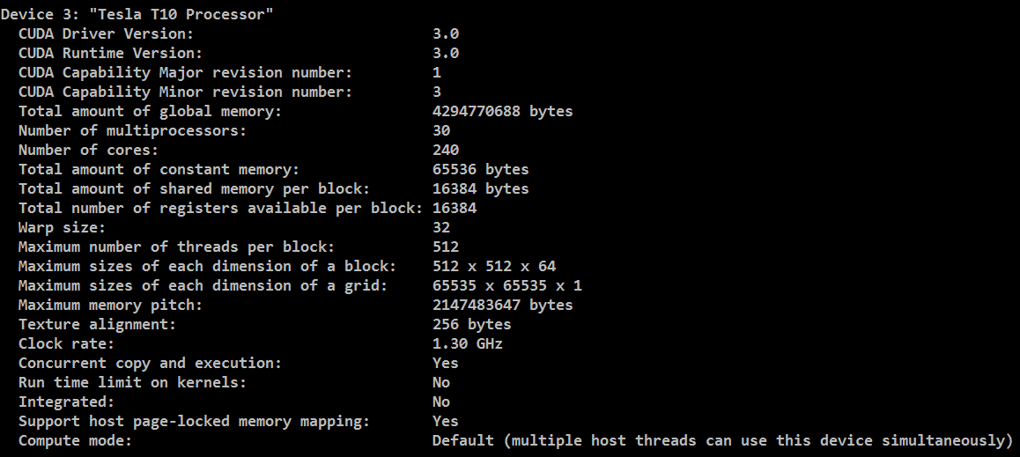
 | Register | Shared | Local | Global
Scope | Thread | Block | Block | Global
Life time | Block | Block | Block | Program
Hardware | On chip | On chip | DRAM | DRAM
Access by host | - | - | - | R/W(API)
Latency | Immediate | 4 clock cycles | 400 – 600 clock cycles | 400 – 600 Clock cycles
deviceQuery
© David Kirk/NVIDIA and Wen-mei W. Hwu, 2007
ECE 498AL, University of Illinois, Urbana-Champaign

Slide 53
Access Times
Register – dedicated HW - single cycle
Shared Memory – dedicated HW - single cycle
Local Memory – DRAM, no cache - *slow*
Global Memory – DRAM, no cache - *slow*
Constant Memory – DRAM, cached, 1…10s…100s of cycles, depending on cache locality
Texture Memory – DRAM, cached, 1…10s…100s of cycles, depending on cache locality
Instruction Memory (invisible) – DRAM, cached
© David Kirk/NVIDIA and Wen-mei W. Hwu, 2007
ECE 498AL, University of Illinois, Urbana-Champaign

Slide 54
Application Programming Interface
The API is an extension to the C programming language
It consists of:
  Language extensions
    To target portions of the code for execution on the device
  A runtime library split into:
    A common component providing built-in vector types and a subset of the C runtime library in both host and device codes
    A host component to control and access one or more devices from the host
    A device component providing device-specific functions
© David Kirk/NVIDIA and Wen-mei W. Hwu, 2007
ECE 498AL, University of Illinois, Urbana-Champaign

Slide 55
Language Extensions:
Variable Type Qualifiers
 | Memory | Scope | Lifetime
__device__ __local__ int LocalVar; | local | thread | thread
__device__ __shared__ int SharedVar; | shared | block | block
__device__ int GlobalVar; | global | grid | application
__device__ __constant__ int ConstantVar; | constant | grid | application
__device__ is optional when used with __local__, __shared__, or __constant__
Automatic variables without any qualifier reside in a register
  Except arrays that reside in local memory
© David Kirk/NVIDIA and Wen-mei W. Hwu, 2007
ECE 498AL, University of Illinois, Urbana-Champaign

Slide 56
Variable Type Restrictions
Pointers can only point to memory allocated or declared in global memory:
  Allocated in the host and passed to the kernel:
  __global__ void KernelFunc(float* ptr)
  Obtained as the address of a global variable: float* ptr = &GlobalVar;
© David Kirk/NVIDIA and Wen-mei W. Hwu, 2007
ECE 498AL, University of Illinois, Urbana-Champaign

Slide 57
Some Additional API Features
© David Kirk/NVIDIA and Wen-mei W. Hwu, 2007
ECE 498AL, University of Illinois, Urbana-Champaign

Slide 58
Language Extensions:
Built-in Variables
dim3 gridDim;
  Dimensions of the grid in blocks (gridDim.z unused)
dim3 blockDim;
  Dimensions of the block in threads
dim3 blockIdx;
  Block index within the grid
dim3 threadIdx;
  Thread index within the block
© David Kirk/NVIDIA and Wen-mei W. Hwu, 2007
ECE 498AL, University of Illinois, Urbana-Champaign

Slide 59
Common Runtime Component
Provides:
  Built-in vector types
  A subset of the C runtime library supported in both host and device codes
© David Kirk/NVIDIA and Wen-mei W. Hwu, 2007
ECE 498AL, University of Illinois, Urbana-Champaign

Slide 60
Common Runtime Component:
Built-in Vector Types
[u]char[1..4], [u]short[1..4], [u]int[1..4], [u]long[1..4], float[1..4]
  Structures accessed with x, y, z, w fields:
  uint4 param;
  int y = param.y;
dim3
  Based on uint3
  Used to specify dimensions
© David Kirk/NVIDIA and Wen-mei W. Hwu, 2007
ECE 498AL, University of Illinois, Urbana-Champaign

Slide 61
Common Runtime Component:
Mathematical Functions
pow, sqrt, cbrt, hypot
exp, exp2, expm1
log, log2, log10, log1p
sin, cos, tan, asin, acos, atan, atan2
sinh, cosh, tanh, asinh, acosh, atanh
ceil, floor, trunc, round
Etc.
  When executed on the host, a given function uses the C runtime implementation if available
  These functions are only supported for scalar types, not vector types
© David Kirk/NVIDIA and Wen-mei W. Hwu, 2007
ECE 498AL, University of Illinois, Urbana-Champaign

Slide 62
Host Runtime Component
Provides functions to deal with:
  Device management (including multi-device systems)
  Memory management
  Error handling
Initializes the first time a runtime function is called
A host thread can invoke device code on only one device
  Multiple host threads required to run on multiple devices
© David Kirk/NVIDIA and Wen-mei W. Hwu, 2007
ECE 498AL, University of Illinois, Urbana-Champaign

Slide 63
Host Runtime Component:
Memory Management
Device memory allocation
  cudaMalloc(), cudaFree()
Memory copy from host to device, device to host, device to device
  cudaMemcpy(), cudaMemcpy2D(), cudaMemcpyToSymbol(), cudaMemcpyFromSymbol()
Memory addressing
  cudaGetSymbolAddress()
What is the difference between cudaMemcpy() and
cudaMemcpyToSymbol()? cudaMemcpy can also beused to copy from host to device memory.
© David Kirk/NVIDIA and Wen-mei W. Hwu, 2007
ECE 498AL, University of Illinois, Urbana-Champaign
Notes:
cudaMemcpy2D() copies a rectangular piece of memory from one memory area to another. Both areas may not overlap.
cudaMemcpyToSymbol() copies bytes from the memory area pointed to by a host pointer to the memory area pointed to by a device variable.
cudaMemcpyFromSymbol() copies bytes from the memory area pointed to by a device variable to the memory area pointed to by a host pointer.
cudaGetSymbolAddress() returns the address of a device variable.

Slide 64
Device Runtime Component:
Mathematical Functions
Some mathematical functions (e.g. sin(x)) have a less accurate, but faster device-only version (e.g. __sin(x))
  __pow
  __log, __log2, __log10
  __exp
  __sin, __cos, __tan
© David Kirk/NVIDIA and Wen-mei W. Hwu, 2007
ECE 498AL, University of Illinois, Urbana-Champaign

Slide 65
Device Runtime Component:
Synchronization Function
void __syncthreads();
Synchronizes all threads in a block
Once all threads have reached this point, execution resumes normally
Used to avoid RAW/WAR/WAW hazards when accessing shared or global memory
Allowed in conditional constructs only if the conditional is uniform across the entire thread block
© David Kirk/NVIDIA and Wen-mei W. Hwu, 2007
ECE 498AL, University of Illinois, Urbana-Champaign

Slide 66
Some Useful Information on Tools
© David Kirk/NVIDIA and Wen-mei W. Hwu, 2007
ECE 498AL, University of Illinois, Urbana-Champaign

Slide 67
Compilation
Any source file containing CUDA language extensions must be compiled with nvcc
nvcc is a compiler driver
  Works by invoking all the necessary tools and compilers like cudacc, g++, cl, ...
nvcc can output:
  Either C code
    That must then be compiled with the rest of the application using another tool
  Or object code directly
© David Kirk/NVIDIA and Wen-mei W. Hwu, 2007
ECE 498AL, University of Illinois, Urbana-Champaign

Slide 68
Linking
Any executable with CUDA code requires two dynamic libraries:
  The CUDA runtime library (cudart)
  The CUDA core library (cuda)
© David Kirk/NVIDIA and Wen-mei W. Hwu, 2007
ECE 498AL, University of Illinois, Urbana-Champaign

Slide 69
Debugging Using the
Device Emulation Mode
An executable compiled in device emulation mode (nvcc -deviceemu) runs completely on the host using the CUDA runtime
  No need of any device and CUDA driver
  Each device thread is emulated with a host thread
When running in device emulation mode, one can:
  Use host native debug support (breakpoints, inspection, etc.)
  Access any device-specific data from host code and vice-versa
  Call any host function from device code (e.g. printf) and vice-versa
  Detect deadlock situations caused by improper usage of __syncthreads
© David Kirk/NVIDIA and Wen-mei W. Hwu, 2007
ECE 498AL, University of Illinois, Urbana-Champaign

Slide 70
Device Emulation Mode Pitfalls
Emulated device threads execute sequentially, so simultaneous accesses of the same memory location by multiple threads could produce different results.
Dereferencing device pointers on the host or host pointers on the device can produce correct results in device emulation mode, but will generate an error in device execution mode
Results of floating-point computations will slightly differ because of:
  Different compiler outputs, instruction sets
  Use of extended precision for intermediate results
    There are various options to force strict single precision on the host
© David Kirk/NVIDIA and Wen-mei W. Hwu, 2007
ECE 498AL, University of Illinois, Urbana-Champaign
Notes:
What are the options that the students can use?

Slide 71
Threading Hardware in G80
© David Kirk/NVIDIA and Wen-mei W. Hwu, 2007
ECE 498AL, University of Illinois, Urbana-Champaign

Slide 72
Single-Program Multiple-Data (SPMD)
CUDA integrated CPU + GPU application C program
  Serial C code executes on CPU
  Parallel Kernel C code executes on GPU thread blocks
CPU Serial Code
Grid 0
GPU Parallel Kernel
KernelA<<< nBlk, nTid >>>(args);
. . .
CPU Serial Code
Grid 1
GPU Parallel Kernel
KernelB<<< nBlk, nTid >>>(args);
. . .
© David Kirk/NVIDIA and Wen-mei W. Hwu, 2007
ECE 498AL, University of Illinois, Urbana-Champaign

Slide 73
Grids and Blocks: CUDA Review
A kernel is executed as a grid of thread blocks
  All threads share data memory space
A thread block is a batch of threads that can cooperate with each other by:
  Synchronizing their execution
    For hazard-free shared memory accesses
  Efficiently sharing data through a low latency shared memory
  Two threads from two different blocks cannot cooperate
Host
Device
Grid 1
Kernel 1
Block
(0, 0)
Block
(1, 0)
Block
(2, 0)
Block
(0, 1)
Block
(1, 1)
Block
(2, 1)
Grid 2
Kernel 2
Block (1, 1)
Thread
(0, 0)
Thread
(1, 0)
Thread
(2, 0)
Thread
(3, 0)
Thread
(4, 0)
Thread
(0, 1)
Thread
(1, 1)
Thread
(2, 1)
Thread
(3, 1)
Thread
(4, 1)
Thread
(0, 2)
Thread
(1, 2)
Thread
(2, 2)
Thread
(3, 2)
Thread
(4, 2)
© David Kirk/NVIDIA and Wen-mei W. Hwu, 2007
ECE 498AL, University of Illinois, Urbana-Champaign
Courtesy: NVIDIA

Slide 74
CUDA Thread Block: Review
Programmer declares (Thread) Block:
  Block size 1 to 512 concurrent threads
  Block shape 1D, 2D, or 3D
  Block dimensions in threads
All threads in a Block execute the same thread program
Threads have thread id numbers within Block
Threads share data and synchronize while doing their share of the work
Thread program uses thread id to select work and address shared data
CUDA Thread Block
Thread Id #:
0 1 2 3 … m
Thread program
Courtesy: John Nickolls, NVIDIA
© David Kirk/NVIDIA and Wen-mei W. Hwu, 2007
ECE 498AL, University of Illinois, Urbana-Champaign

Slide 75
GeForce-8 Series HW Overview
Streaming Processor Array
…
TPC
TPC
TPC
TPC
TPC
TPC
Texture Processor Cluster
Streaming Multiprocessor
Instruction L1
Data L1
SM
Instruction Fetch/Dispatch
Shared Memory
TEX
SP
SP
SM
SP
SP
SFU
SFU
SP
SP
SP
SP
© David Kirk/NVIDIA and Wen-mei W. Hwu, 2007
ECE 498AL, University of Illinois, Urbana-Champaign

Slide 76
CUDA Processor Terminology
SPA
  Streaming Processor Array (variable across GeForce 8-series, 8 in GeForce8800)
TPC
  Texture Processor Cluster (2 SM + TEX)
SM
  Streaming Multiprocessor (8 SP)
  Multi-threaded processor core
  Fundamental processing unit for CUDA thread block
SP
  Streaming Processor
  Scalar ALU for a single CUDA thread
© David Kirk/NVIDIA and Wen-mei W. Hwu, 2007
ECE 498AL, University of Illinois, Urbana-Champaign

Slide 77
Streaming Multiprocessor (SM)
Streaming Multiprocessor (SM)
  8 Streaming Processors (SP)
  2 Super Function Units (SFU)
Multi-threaded instruction dispatch
  1 to 512 threads active
  Shared instruction fetch per 32 threads
  Cover latency of texture/memory loads
20+ GFLOPS
16 KB shared memory
DRAM texture and memory access
Streaming Multiprocessor
Instruction L1
Data L1
Instruction Fetch/Dispatch
Shared Memory
SP
SP
SP
SP
SFU
SFU
SP
SP
SP
SP
© David Kirk/NVIDIA and Wen-mei W. Hwu, 2007
ECE 498AL, University of Illinois, Urbana-Champaign

Slide 78
G80 Thread Computing Pipeline
Processors execute computing threads
Alternative operating mode specifically for computing
The future of GPUs is programmable processing
So – build the architecture around the processor
Host
Generates Thread grids based on kernel calls
Host
Input Assembler
Input Assembler
Setup / Rstr / ZCull
Thread Execution Manager
Vtx Thread Issue
Geom Thread Issue
Pixel Thread Issue
SP
SP
SP
SP
SP
SP
SP
SP
SP
SP
SP
SP
SP
SP
SP
SP
Thread Processor
Parallel Data
Cache
Parallel Data
Cache
Parallel Data
Cache
Parallel Data
Cache
Parallel Data
Cache
Parallel Data
Cache
Parallel Data
Cache
Parallel Data
Cache
TF
L1
TF
L1
TF
L1
TF
L1
TF
L1
TF
L1
TF
L1
TF
L1
Texture
Texture
Texture
Texture
Texture
Texture
Texture
Texture
Texture
Load/store
L2
Load/store
L2
Load/store
Load/store
Load/store
Load/store
L2
L2
L2
L2
Global Memory
FB
FB
FB
FB
FB
FB
© David Kirk/NVIDIA and Wen-mei W. Hwu, 2007
ECE 498AL, University of Illinois, Urbana-Champaign

Slide 79
Thread Life Cycle in HW
Host
Device
Grid is launched on the SPA
Thread Blocks are serially distributed to all the SM’s
  Potentially >1 Thread Block per SM
Each SM launches Warps of Threads
  2 levels of parallelism
SM schedules and executes Warps that are ready to run
As Warps and Thread Blocks complete, resources are freed
  SPA can distribute more Thread Blocks
Grid 1
Kernel 1
Block
(0, 0)
Block
(1, 0)
Block
(2, 0)
Block
(0, 1)
Block
(1, 1)
Block
(2, 1)
Grid 2
Kernel 2
Block (1, 1)
Thread
(0, 0)
Thread
(1, 0)
Thread
(2, 0)
Thread
(3, 0)
Thread
(4, 0)
Thread
(0, 1)
Thread
(1, 1)
Thread
(2, 1)
Thread
(3, 1)
Thread
(4, 1)
Thread
(0, 2)
Thread
(1, 2)
Thread
(2, 2)
Thread
(3, 2)
Thread
(4, 2)
© David Kirk/NVIDIA and Wen-mei W. Hwu, 2007
ECE 498AL, University of Illinois, Urbana-Champaign

Slide 80
SM Executes Blocks
SM 0
SM 1
t0 t1 t2 … tm
t0 t1 t2 … tm
MT IU
MT IU
Blocks
SP
SP
Threads are assigned to SMs in Block granularity
  Up to 8 Blocks to each SM as resource allows
  SM in G80 can take up to 768 threads
    Could be 256 (threads/block) * 3 blocks
    Or 128 (threads/block) * 6 blocks, etc.
Threads run concurrently
  SM assigns/maintains thread id #s
  SM manages/schedules thread execution
Blocks
Shared
Memory
Shared
Memory
Texture L1
TF
L2
Memory
© David Kirk/NVIDIA and Wen-mei W. Hwu, 2007
ECE 498AL, University of Illinois, Urbana-Champaign

Slide 81
Thread Scheduling/Execution
Each Thread Blocks is divided in 32-thread Warps
  This is an implementation decision, not part of the CUDA programming model
Warps are scheduling units in SM
If 3 blocks are assigned to an SM and each Block has 256 threads, how many Warps are there in an SM?
  Each Block is divided into 256/32 = 8 Warps
  There are 8 * 3 = 24 Warps
  At any point in time, only one of the 24 Warps will be selected for instruction fetch and execution.
…
Block 1 Warps
…
Block 2 Warps
…
…
t0 t1 t2 … t31
t0 t1 t2 … t31
Streaming Multiprocessor
Instruction L1
Data L1
Instruction Fetch/Dispatch
Shared Memory
SP
SP
SP
SP
SFU
SFU
SP
SP
SP
SP
© David Kirk/NVIDIA and Wen-mei W. Hwu, 2007
ECE 498AL, University of Illinois, Urbana-Champaign

Slide 82
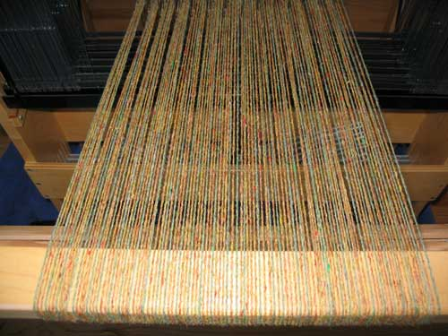
SM Warp Scheduling
SM hardware implements zero-overhead Warp scheduling
  Warps whose next instruction has its operands ready for consumption are eligible for execution
  Eligible Warps are selected for execution on a prioritized scheduling policy
  All threads in a Warp execute the same instruction when selected
4 clock cycles needed to dispatch the same instruction for all threads in a Warp in G80
  If one global memory access is needed for every 4 instructions
  A minimal of 13 Warps are needed to fully tolerate 200-cycle memory latency
SM multithreaded
Warp scheduler
time
warp 8 instruction 11
warp 1 instruction 42
warp 3 instruction 95
.
.
.
warp 8 instruction 12
warp 3 instruction 96
© David Kirk/NVIDIA and Wen-mei W. Hwu, 2007
ECE 498AL, University of Illinois, Urbana-Champaign

Slide 83
SM Instruction Buffer – Warp Scheduling
Fetch one warp instruction/cycle
  from instruction L1 cache
  into any instruction buffer slot
Issue one “ready-to-go” warp instruction/cycle
  from any warp - instruction buffer slot
  operand scoreboarding used to prevent hazards
Issue selection based on round-robin/age of warp
SM broadcasts the same instruction to 32 Threads of a Warp
I
$
L
1
Multithreaded
Instruction Buffer
R
C
$
Shared
F
L
1
Mem
Operand Select
MAD
SFU
© David Kirk/NVIDIA and Wen-mei W. Hwu, 2007
ECE 498AL, University of Illinois, Urbana-Champaign

Slide 84
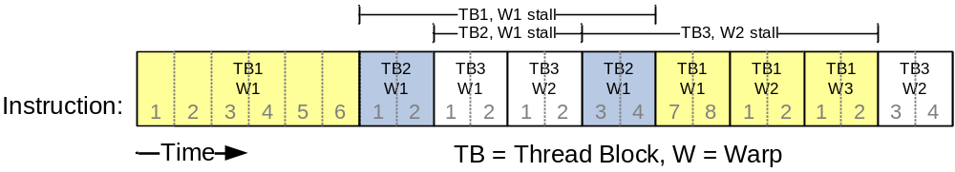
Scoreboarding
All register operands of all instructions in the Instruction Buffer are scoreboarded
  Status becomes ready after the needed values are deposited
  prevents hazards
  cleared instructions are eligible for issue
Decoupled Memory/Processor pipelines
  any thread can continue to issue instructions until scoreboarding prevents issue
  allows Memory/Processor ops to proceed in shadow of Memory/Processor ops
© David Kirk/NVIDIA and Wen-mei W. Hwu, 2007
ECE 498AL, University of Illinois, Urbana-Champaign

Slide 85
CUDA Device Memory Space: Review
Each thread can:
  R/W per-thread registers
  R/W per-thread local memory
  R/W per-block shared memory
  R/W per-grid global memory
  Read only per-grid constant memory
  Read only per-grid texture memory
(Device) Grid
Block (0, 0)
Block (1, 0)
Shared Memory
Shared Memory
Registers
Registers
Registers
Registers
Thread (0, 0)
Thread (1, 0)
Thread (0, 0)
Thread (1, 0)
Local
Memory
Local
Memory
Local
Memory
Local
Memory
The host can R/W global, constant, and texture memories
Host
Global
Memory
Constant
Memory
Texture
Memory
© David Kirk/NVIDIA and Wen-mei W. Hwu, 2007
ECE 498AL, University of Illinois, Urbana-Champaign
Notes:
Global, constant, and texture memory spaces are persistent across kernels called by the same application.

Slide 86
Parallel Memory Sharing
Thread
Local Memory: per-thread
  Private per thread
  Auto variables, register spill
Shared Memory: per-Block
  Shared by threads of the same block
  Inter-thread communication
Global Memory: per-application
  Shared by all threads
  Inter-Grid communication
Local Memory
Block
Shared
Memory
Grid 0
Global
Memory
. . .
Sequential
Grids
in Time
Grid 1
. . .
© David Kirk/NVIDIA and Wen-mei W. Hwu, 2007
ECE 498AL, University of Illinois, Urbana-Champaign

Slide 87
HW Overview
Streaming Processor Array
TPC
TPC
TPC
TPC
TPC
TPC
TPC
TPC
Texture Processor Cluster
Streaming Multiprocessor
Instruction L1
Data L1
SM
Instruction Fetch/Dispatch
Shared Memory
TEX
SP
SP
SM
SP
SP
SFU
SFU
SP
SP
SP
SP
© David Kirk/NVIDIA and Wen-mei W. Hwu, 2007
ECE 498AL, University of Illinois, Urbana-Champaign

Slide 88
SM Memory Architecture
SM 0
SM 1
t0 t1 t2 … tm
t0 t1 t2 … tm
MT IU
MT IU
Blocks
SP
SP
Blocks
Threads in a Block share data & results
  In Memory and Shared Memory
  Synchronize at barrier instruction
Per-Block Shared Memory Allocation
  Keeps data close to processor
  Minimize trips to global Memory
  SM Shared Memory dynamically allocated to Blocks, one of the limiting resources
Shared
Memory
Shared
Memory
Texture L1
TF
Courtesy:
John Nicols, NVIDIA
L2
Memory
© David Kirk/NVIDIA and Wen-mei W. Hwu, 2007
ECE 498AL, University of Illinois, Urbana-Champaign

Slide 89
SM Register File
Register File (RF)
  32 KB
  Provides 4 operands/clock
TEX pipe can also read/write RF
  2 SMs share 1 TEX
Load/Store pipe can also read/write RF
I
$
L
1
Multithreaded
Instruction Buffer
R
C
$
Shared
F
L
1
Mem
Operand Select
MAD
SFU
© David Kirk/NVIDIA and Wen-mei W. Hwu, 2007
ECE 498AL, University of Illinois, Urbana-Champaign

Slide 90
Programmer View of Register File
4 blocks
3 blocks
There are 8192 registers in each SM in G80
  This is an implementation decision, not part of CUDA
  Registers are dynamically partitioned across all Blocks assigned to the SM
  Once assigned to a Block, the register is NOT accessible by threads in other Blocks
  Each thread in the same Block only access registers assigned to itself
© David Kirk/NVIDIA and Wen-mei W. Hwu, 2007
ECE 498AL, University of Illinois, Urbana-Champaign

Slide 91
Matrix Multiplication Example
If each Block has 16X16 threads and each thread uses 10 registers, how many thread can run on each SM?
  Each Block requires 10*256 = 2560 registers
  8192 = 3 * 2560 + change
  So, three blocks can run on an SM as far as registers are concerned
How about if each thread increases the use of registers by 1?
  Each Block now requires 11*256 = 2816 registers
  8192 < 2816 *3
  Only two Blocks can run on an SM, 1/3 reduction of parallelism!!!
© David Kirk/NVIDIA and Wen-mei W. Hwu, 2007
ECE 498AL, University of Illinois, Urbana-Champaign

Slide 92
More on Dynamic Partitioning
Dynamic partitioning gives more flexibility to compilers/programmers
  One can run a smaller number of threads that require many registers each or a large number of threads that require few registers each
    This allows for finer grain threading than traditional CPU threading models.
  The compiler can tradeoff between instruction-level parallelism and thread level parallelism
© David Kirk/NVIDIA and Wen-mei W. Hwu, 2007
ECE 498AL, University of Illinois, Urbana-Champaign

Slide 93
ILP vs. TLP Example
Assume that a kernel has 256-thread Blocks, 4 independent instructions for each global memory load in the thread program, and each thread uses 10 registers, global laods have 200 cycles
  3 Blocks can run on each SM
If a Compiler can use one more register to change the dependence pattern so that 8 independent instructions exist for each global memory load
  Only two can run on each SM
  However, one only needs 200/(8*4) = 7 Warps to tolerate the memory latency
  Two Blocks have 16 Warps. The performance can be actually higher!
© David Kirk/NVIDIA and Wen-mei W. Hwu, 2007
ECE 498AL, University of Illinois, Urbana-Champaign

Slide 94
Constants
Immediate address constants
Indexed address constants
Constants stored in DRAM, and cached on chip
  L1 per SM
A constant value can be broadcast to all threads in a Warp
  Extremely efficient way of accessing a value that is common for all threads in a Block!
I
$
L
1
Multithreaded
Instruction Buffer
R
C
$
Shared
F
L
1
Mem
Operand Select
MAD
SFU
© David Kirk/NVIDIA and Wen-mei W. Hwu, 2007
ECE 498AL, University of Illinois, Urbana-Champaign

Slide 95
Shared Memory
Each SM has 16 KB of Shared Memory
  16 banks of 32bit words
CUDA uses Shared Memory as shared storage visible to all threads in a thread block
  read and write access
Not used explicitly for pixel shader programs
  we dislike pixels talking to each other ☺
I
$
L
1
Multithreaded
Instruction Buffer
R
C
$
Shared
F
L
1
Mem
Operand Select
MAD
SFU
© David Kirk/NVIDIA and Wen-mei W. Hwu, 2007
ECE 498AL, University of Illinois, Urbana-Champaign

Slide 96
Multiply Using Several Blocks
bx
One block computes one square sub-matrix P_{sub} of size BLOCK_SIZE
One thread computes one element of P_{sub}
Assume that the dimensions of M and N are multiples of BLOCK_SIZE and square shape
0
1
2
tx
0
bsize-1
1
2
N
BLOCK_SIZE
N.height
BLOCK_SIZE
M
P
0
0
P_{sub}
1
by
2
M.height
1
ty
BLOCK_SIZE
bsize-1
2
BLOCK_SIZE
BLOCK_SIZE
BLOCK_SIZE
© David Kirk/NVIDIA and Wen-mei W. Hwu, 2007
ECE 498AL, University of Illinois, Urbana-Champaign
M.width
N.width

Slide 97
Matrix Multiplication
Shared Memory Usage
Each Block requires 2* WIDTH² * 4 bytes of shared memory storage
  For WIDTH = 16, each BLOCK requires 2KB, up to 8 Blocks can fit into the Shared Memory of an SM
  Since each SM can only take 768 threads, each SM can only take 3 Blocks of 256 threads each
  Shared memory size is not a limitation for Matrix Multiplication of
© David Kirk/NVIDIA and Wen-mei W. Hwu, 2007
ECE 498AL, University of Illinois, Urbana-Champaign

Slide 98
Parallel Memory Architecture
In a parallel machine, many threads access memory
  Therefore, memory is divided into banks
  Essential to achieve high bandwidth
Each bank can service one address per cycle
  A memory can service as many simultaneous
  accesses as it has banks
Multiple simultaneous accesses to a bank
result in a bank conflict
  Conflicting accesses are serialized
Bank 0
Bank 1
Bank 2
Bank 3
Bank 4
Bank 5
Bank 6
Bank 7
Bank 15
© David Kirk/NVIDIA and Wen-mei W. Hwu, 2007
ECE 498AL, University of Illinois, Urbana-Champaign

Slide 99
Bank Addressing Examples
No Bank Conflicts
  Linear addressing
  stride == 1
No Bank Conflicts
  Random 1:1 Permutation
Thread 0
Bank 0
Thread 0
Bank 0
Thread 1
Bank 1
Thread 1
Bank 1
Thread 2
Bank 2
Thread 2
Bank 2
Thread 3
Bank 3
Thread 3
Bank 3
Thread 4
Bank 4
Thread 4
Bank 4
Thread 5
Bank 5
Thread 5
Bank 5
Thread 6
Bank 6
Thread 6
Bank 6
Thread 7
Bank 7
Thread 7
Bank 7
Thread 15
Bank 15
Thread 15
Bank 15
© David Kirk/NVIDIA and Wen-mei W. Hwu, 2007
ECE 498AL, University of Illinois, Urbana-Champaign

Slide 100
Bank Addressing Examples
2-way Bank Conflicts
  Linear addressing
  stride == 2
8-way Bank Conflicts
  Linear addressing
  stride == 8
Thread 0
Bank 0
Thread 0
x8
Bank 0
Thread 1
Bank 1
Thread 1
Bank 1
Thread 2
Bank 2
Thread 2
Bank 2
Thread 3
Bank 3
Thread 3
Thread 4
Bank 4
Thread 4
Bank 5
Thread 5
Bank 7
Bank 6
Thread 6
Bank 8
Bank 7
Thread 7
Bank 9
Thread 8
x8
Thread 9
Thread 10
Thread 11
Bank 15
Thread 15
Bank 15
© David Kirk/NVIDIA and Wen-mei W. Hwu, 2007
ECE 498AL, University of Illinois, Urbana-Champaign

Slide 101
How addresses map to banks on G80
Each bank has a bandwidth of 32 bits per clock cycle
Successive 32-bit words are assigned to successive banks
G80 has 16 banks
  So bank = address % 16
  Same as the size of a half-warp
    No bank conflicts between different half-warps, only within a single half-warp
© David Kirk/NVIDIA and Wen-mei W. Hwu, 2007
ECE 498AL, University of Illinois, Urbana-Champaign

Slide 102
Shared memory bank conflicts
Shared memory is as fast as registers if there are no bank conflicts
The fast case:
  If all threads of a half-warp access different banks, there is no bank conflict
  If all threads of a half-warp access the identical address, there is no bank conflict (broadcast)
The slow case:
  Bank Conflict: multiple threads in the same half-warp access the same bank
  Must serialize the accesses
  Cost = max # of simultaneous accesses to a single bank
© David Kirk/NVIDIA and Wen-mei W. Hwu, 2007
ECE 498AL, University of Illinois, Urbana-Champaign

Slide 103
Linear Addressing
s=1
Given:
__shared__ float shared[256];
float foo =
shared[baseIndex + s * threadIdx.x];
This is only bank-conflict-free if s shares no common factors with the number of banks
  16 on G80, so s must be odd
Thread 0
Bank 0
Thread 1
Bank 1
Thread 2
Bank 2
Thread 3
Bank 3
Thread 4
Bank 4
Thread 5
Bank 5
Thread 6
Bank 6
Thread 7
Bank 7
Thread 15
Bank 15
s=3
Thread 0
Bank 0
Thread 1
Bank 1
Thread 2
Bank 2
Thread 3
Bank 3
Thread 4
Bank 4
Thread 5
Bank 5
Thread 6
Bank 6
Thread 7
Bank 7
© David Kirk/NVIDIA and Wen-mei W. Hwu, 2007
ECE 498AL, University of Illinois, Urbana-Champaign
Thread 15
Bank 15

Slide 104
Data types and bank conflicts
This has no conflicts if type of shared is 32-bits:
foo = shared[baseIndex + threadIdx.x]
But not if the data type is smaller
  4-way bank conflicts:
  __shared__ char shared[];
  foo = shared[baseIndex + threadIdx.x];
  2-way bank conflicts:
  __shared__ short shared[];
  foo = shared[baseIndex + threadIdx.x];
Thread 0
Bank 0
Thread 1
Bank 1
Thread 2
Bank 2
Thread 3
Bank 3
Thread 4
Bank 4
Thread 5
Bank 5
Thread 6
Bank 6
Thread 7
Bank 7
Thread 15
Bank 15
Thread 0
Bank 0
Thread 1
Bank 1
Thread 2
Bank 2
Thread 3
Bank 3
Thread 4
Bank 4
Thread 5
Bank 5
Thread 6
Bank 6
Thread 7
Bank 7
© David Kirk/NVIDIA and Wen-mei W. Hwu, 2007
ECE 498AL, University of Illinois, Urbana-Champaign
Thread 15
Bank 15

Slide 105
Structs and Bank Conflicts
Struct assignments compile into as many memory accesses as there are struct members:
  struct vector { float x, y, z; };
  struct myType {
  float f;
  int c;
  };
  __shared__ struct vector vectors[64];
  __shared__ struct myType myTypes[64];
This has no bank conflicts for vector; struct size is 3 words
  3 accesses per thread, contiguous banks (no common factor with 16)
  struct vector v = vectors[baseIndex + threadIdx.x];
This has 2-way bank conflicts for my Type; (2 accesses per thread)
  struct myType m = myTypes[baseIndex + threadIdx.x];
Thread 0
Bank 0
Thread 1
Bank 1
Thread 2
Bank 2
Thread 3
Bank 3
Thread 4
Bank 4
Thread 5
Bank 5
Thread 6
Bank 6
Thread 7
Bank 7
Thread 15
Bank 15
© David Kirk/NVIDIA and Wen-mei W. Hwu, 2007
ECE 498AL, University of Illinois, Urbana-Champaign

Slide 106
Common Array Bank Conflict Patterns
1D
Each thread loads 2 elements into shared mem:
  2-way-interleaved loads result in
  2-way bank conflicts:
int tid = threadIdx.x;
shared[2*tid] = global[2*tid];
shared[2*tid+1] = global[2*tid+1];
This makes sense for traditional CPU threads, locality in cache line usage and reduced sharing traffice.
  Not in shared memory usage where there is no cache line effects but banking effects
Thread 0
Bank 0
Thread 1
Bank 1
Thread 2
Bank 2
Thread 3
Bank 3
Thread 4
Bank 4
Bank 5
Bank 6
Bank 7
Thread 8
Thread 9
Thread 10
Thread 11
Bank 15
© David Kirk/NVIDIA and Wen-mei W. Hwu, 2007
ECE 498AL, University of Illinois, Urbana-Champaign

Slide 107
A Better Array Access Pattern
Each thread loads one element in every consecutive group of bockDim elements.
  shared[tid] = global[tid];
  shared[tid + blockDim.x] = global[tid + blockDim.x];
Thread 0
Bank 0
Thread 1
Bank 1
Thread 2
Bank 2
Thread 3
Bank 3
Thread 4
Bank 4
Thread 5
Bank 5
Thread 6
Bank 6
Thread 7
Bank 7
Thread 15
Bank 15
© David Kirk/NVIDIA and Wen-mei W. Hwu, 2007
ECE 498AL, University of Illinois, Urbana-Champaign

Slide 108
Vector Reduction with Bank Conflicts
Array elements
0
1
2
3
4
5
6
7
8
9
10
11
1
2
3
© David Kirk/NVIDIA and Wen-mei W. Hwu, 2007
ECE 498AL, University of Illinois, Urbana-Champaign

Slide 109
No Bank Conflicts
0
1
2
3
…
13
14
15
16
17
18
19
1
2
3
© David Kirk/NVIDIA and Wen-mei W. Hwu, 2007
ECE 498AL, University of Illinois, Urbana-Champaign

Slide 110
Common Bank Conflict Patterns (2D)
Bank Indices without Padding
Operating on 2D array of floats in shared memory
  e.g. image processing
Example: 16x16 block
  Each thread processes a row
  So threads in a block access the elements in each column simultaneously (example: row 1 in purple)
  16-way bank conflicts: rows all start at bank 0
Solution 1) pad the rows
  Add one float to the end of each row
Solution 2) transpose before processing
  Suffer bank conflicts during transpose
  But possibly save them later
0
1
2
3
4
5
6
7
15
0
1
2
3
4
5
6
7
15
0
1
2
3
4
5
6
7
15
0
1
2
3
4
5
6
7
15
0
1
2
3
4
5
6
7
15
0
1
2
3
4
5
6
7
15
0
1
2
3
4
5
6
7
15
0
1
2
3
4
5
6
7
15
0
1
2
3
4
5
6
7
15
Bank Indices with Padding
0
1
2
3
4
5
6
7
15
0
1
2
3
4
5
6
7
8
0
1
2
3
4
5
6
7
8
9
1
2
3
4
5
6
7
8
9
10
2
3
4
5
6
7
8
9
10
11
3
4
5
6
7
8
9
10
11
12
4
5
6
7
8
9
10
11
12
13
5
6
7
8
9
10
11
12
13
14
7
8
© David Kirk/NVIDIA and Wen-mei W. Hwu, 2007
ECE 498AL, University of Illinois, Urbana-Champaign
15
0
1
2
3
4
5
6
14
15

Slide 111
Does Matrix Multiplication Incur Shared Memory Bank Conflicts?
0
1
2
3
4
5
6
7
15
0
1
2
3
4
5
6
7
15
0
1
2
3
4
5
6
7
15
0
1
2
3
4
5
6
7
15
0
1
2
3
4
5
6
7
15
All Warps in a Block access the same row of Ms – broadcast!
0
1
2
3
4
5
6
7
15
0
1
2
3
4
5
6
7
15
0
1
2
3
4
5
6
7
15
0
1
2
3
4
5
6
7
15
0
1
2
3
4
5
6
7
15
0
1
2
3
4
5
6
7
15
0
1
2
3
4
5
6
7
15
All Warps in a Block access neighboring elements in a row as they access walk through neighboring columns!
0
1
2
3
4
5
6
7
15
0
1
2
3
4
5
6
7
15
0
1
2
3
4
5
6
7
15
0
1
2
3
4
5
6
7
15
0
1
2
3
4
5
6
7
15
0
1
2
3
4
5
6
7
15
© David Kirk/NVIDIA and Wen-mei W. Hwu, 2007
ECE 498AL, University of Illinois, Urbana-Champaign

Slide 112
Load/Store (Memory read/write) Clustering/Batching
Use LD to hide LD latency (non-dependent LD ops only)
  Use same thread to help hide own latency
Instead of:
  LD 0 (long latency)
  Dependent MATH 0
  LD 1 (long latency)
  Dependent MATH 1
Do:
  LD 0 (long latency)
  LD 1 (long latency - hidden)
  MATH 0
  MATH 1
Compiler handles this!
  But, you must have enough non-dependent LDs and Math
© David Kirk/NVIDIA and Wen-mei W. Hwu, 2007
ECE 498AL, University of Illinois, Urbana-Champaign

